Slide 1
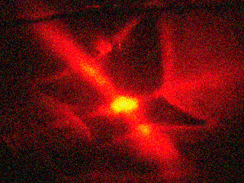
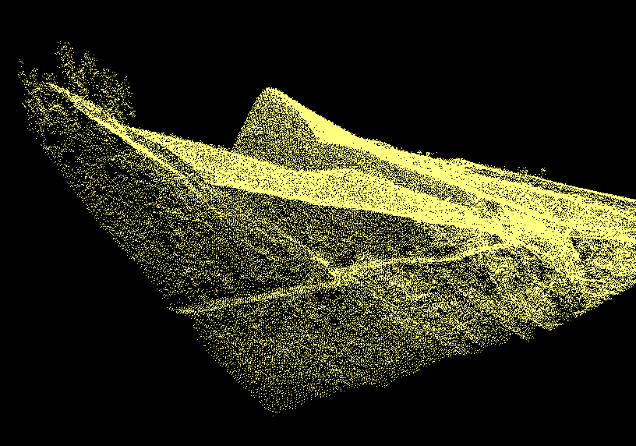
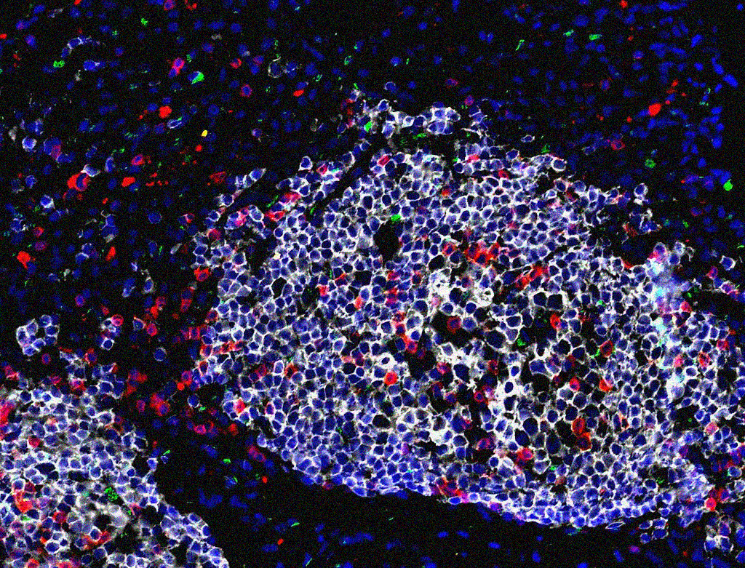
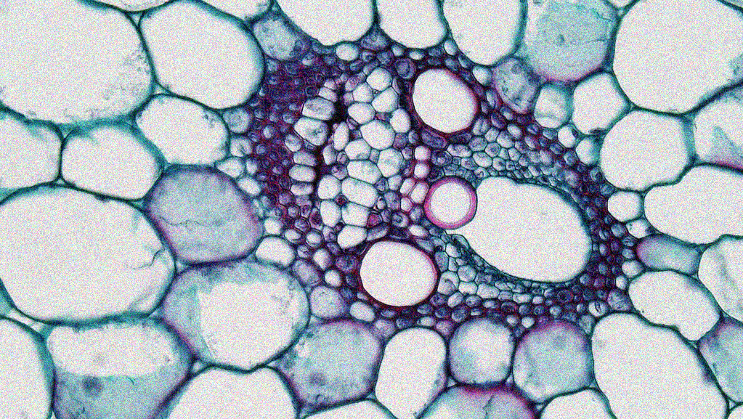
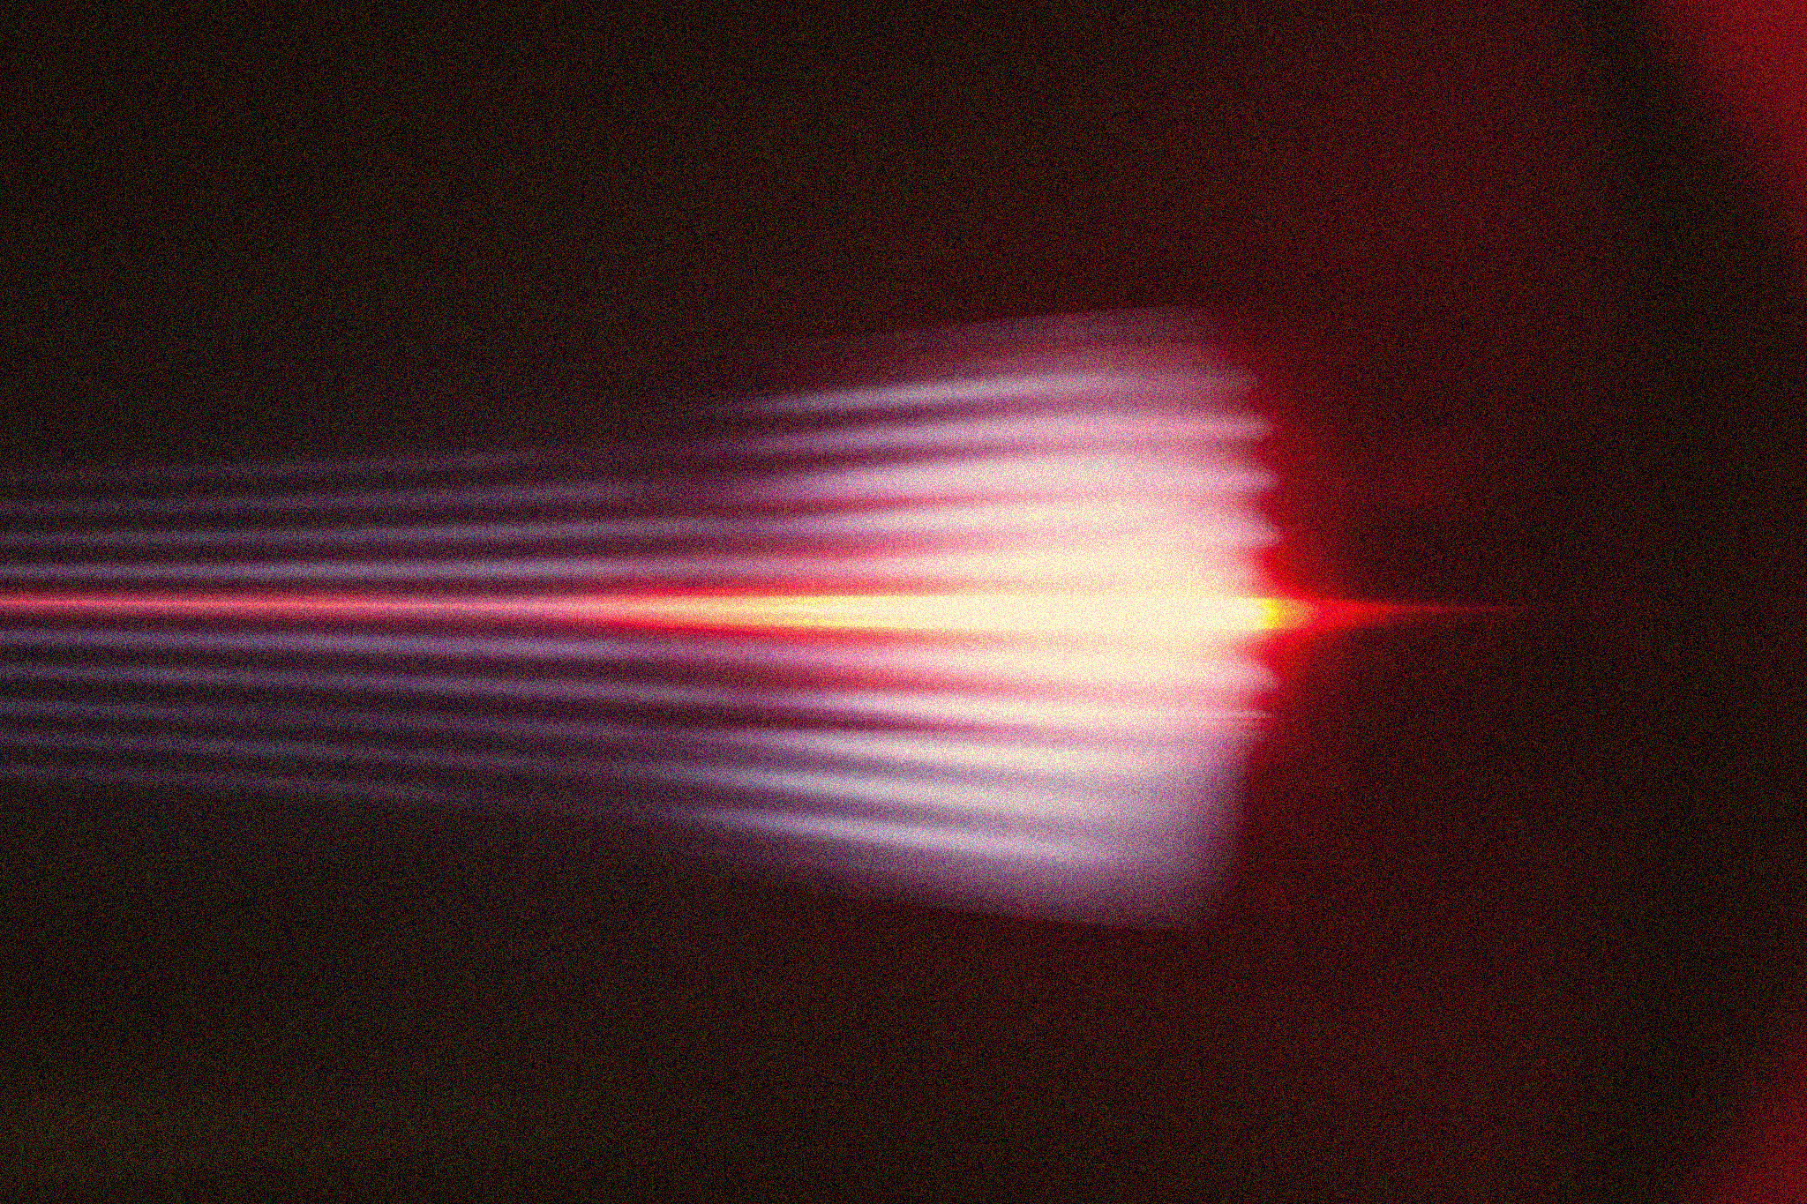
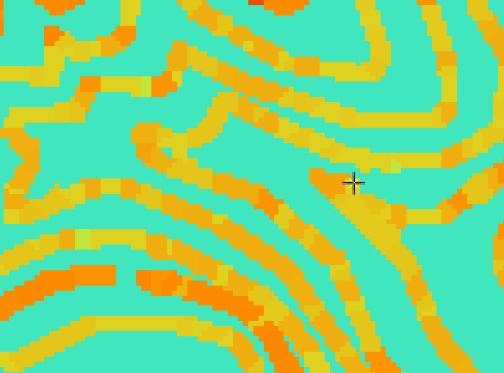

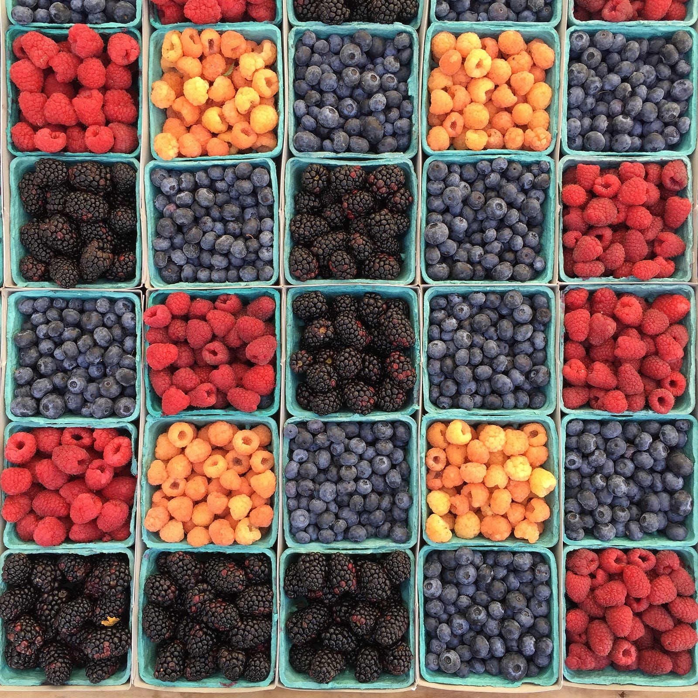
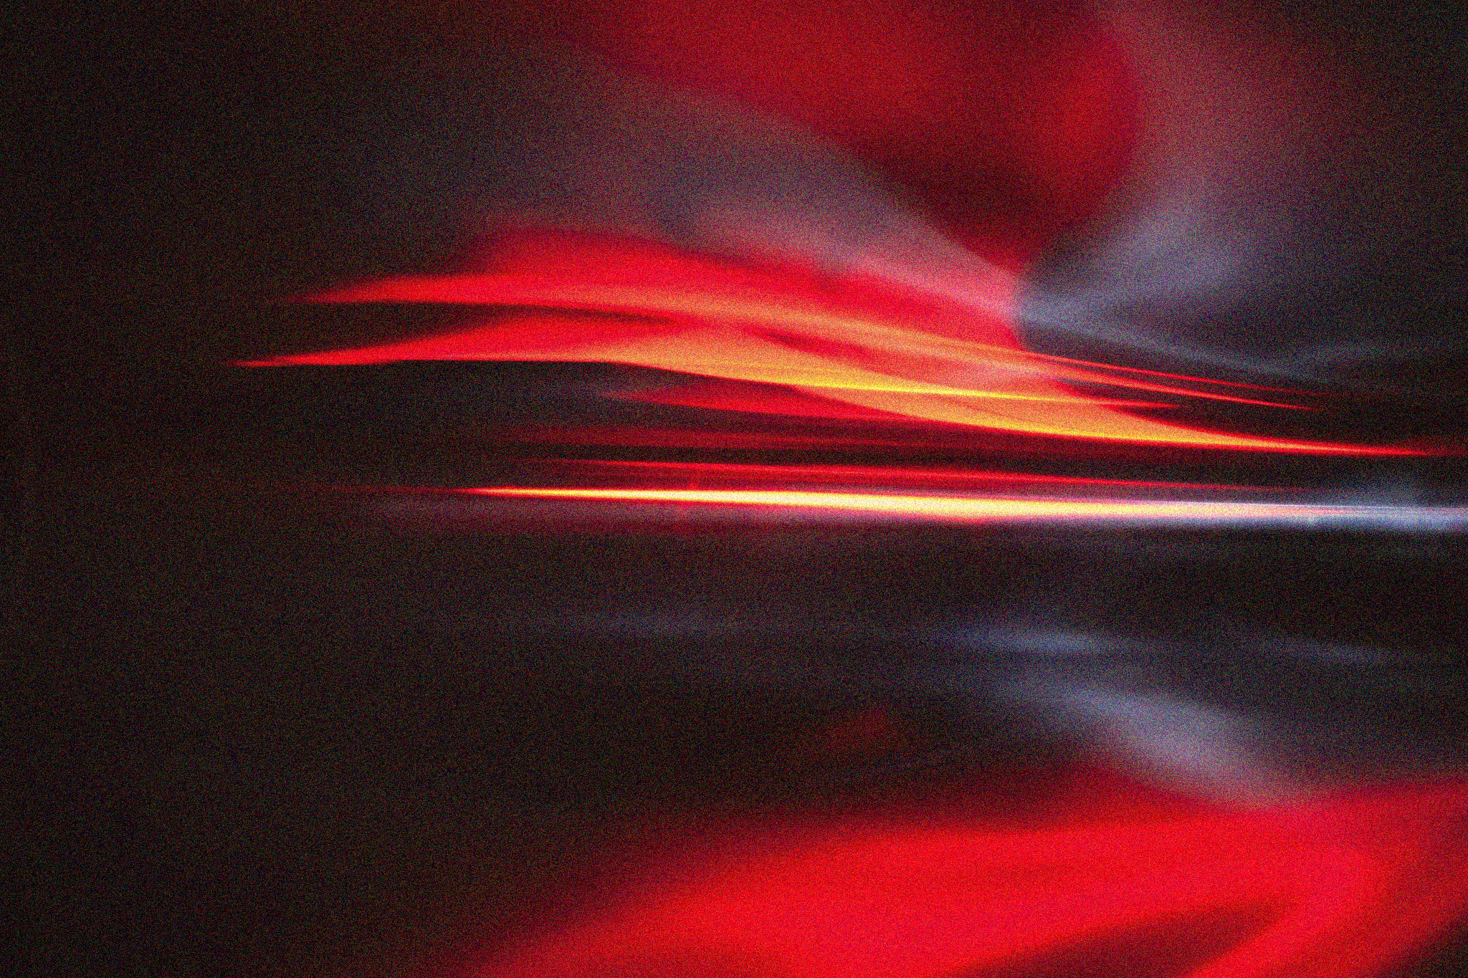
APP PHYSICS 157
COMPUTATIONAL ANALYSIS AND MODELLING
IMAGE SEGMENTATION
IMAGE AND VIDEO PROCESSING – MODULE 1
NINO PHILIP RAMONES | GITHUB
2020 – 05616
MAY16, 2023
This Photo by Unknown Author is licensed under CC BY-NC-ND

Slide 2
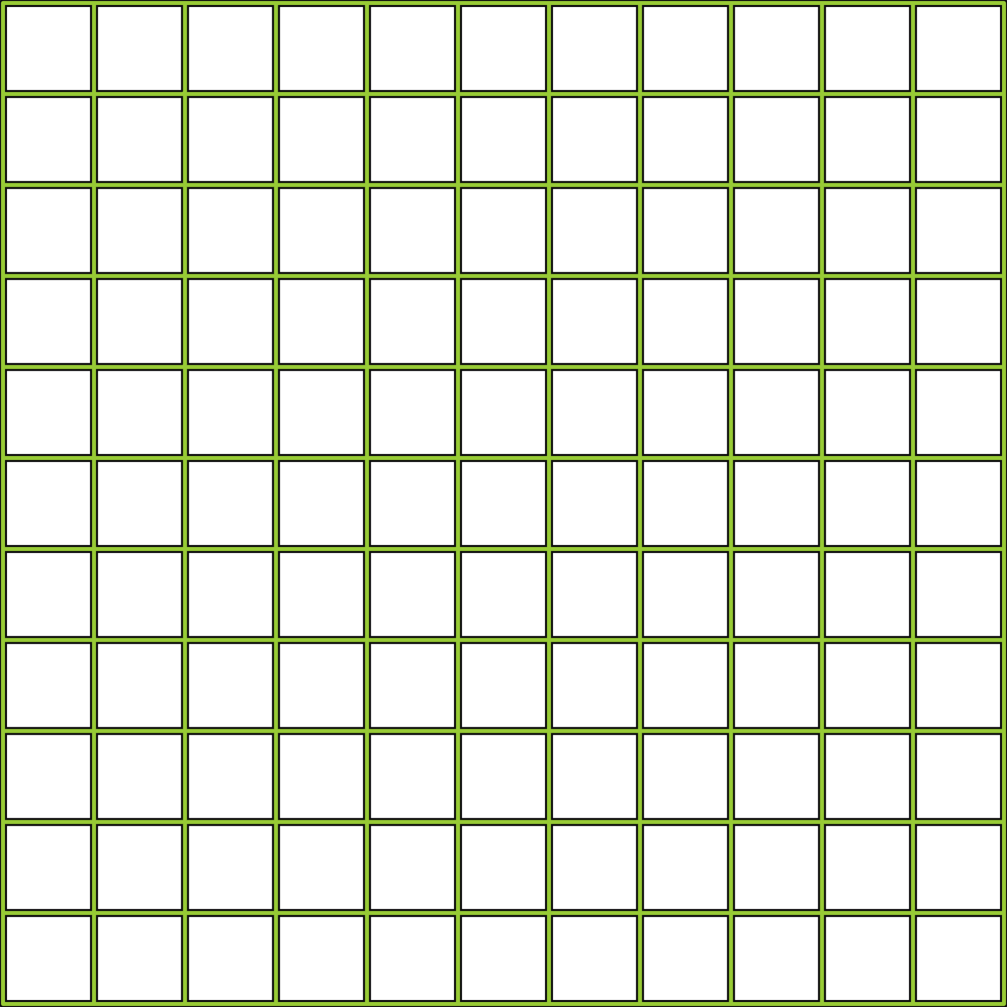
APP PHYSICS 157
PROPERTIES AND APPLICATIONS OF THE 2D FFT
OBJECTIVES
Compare the different segmentation techniques in image processing and account for their strengths and weaknesses
Explore how bin sizes affects the nonparametric estimation in segmenting ROI from images
KEY TAKEAWAYS
Thresholding is useful in image segmentation since it is the simplest way to separate blobs or cells of interest from the background
Parametric segmentation is probabilistic as it takes the Gaussian distribution function as its pixel membership algorithm
Nonparametric segmentation is dependent on the bin sizes and works best for images where the color distribution is uneven
SOME PITFALLS
Segmenting grayscale images through thresholding might not work for some images where different shades and chromaticity of such color is present in the background

Slide 3
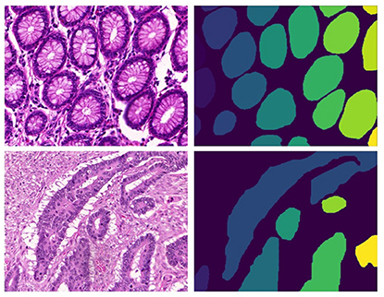
APP PHYSICS 157
IMAGE SEGMENTATION
IMAGE SEGMENTATION
In the previous activity, we have made use and took advantage of ImageJ in segmenting our images. However, it is of utmost importance to learn the basics of image segmentation and the process of automating it since it helps us efficiently gather training data for machine learning in the case of repetitive imaging experiments where ImageJ becomes cumbersome to use. In this activity, we investigate how image segmentation works as well as the methods to segment an object of interest from an image.
In principle, image segmentation involves the picking of a region of interest (ROI) out from the rest of the image such that further processing can be done to it – such as morphological operations and blob analysis – which are the focus of the next activities in the course. This segmenting process take on a given selection rules based on the features unique to such ROI.
Figure 1. This Photo by Unknown Author is licensed under CC BY

Slide 4
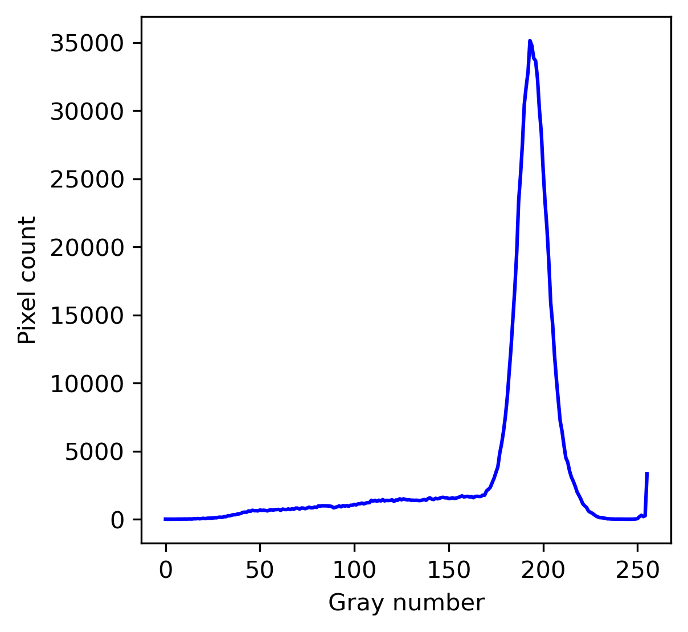
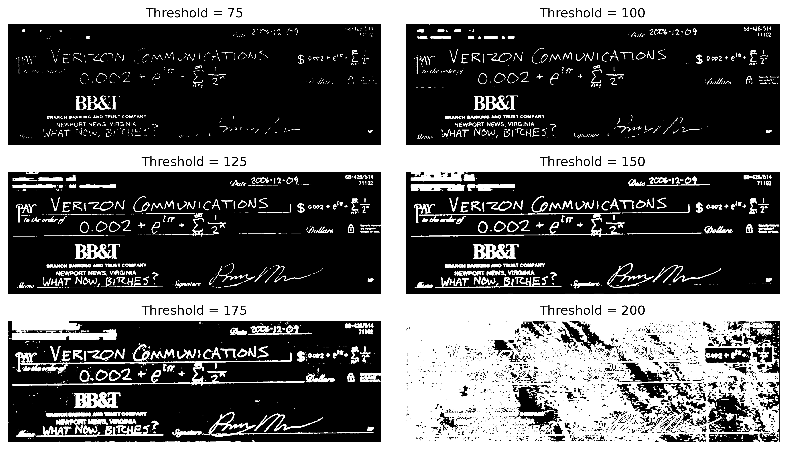
APP PHYSICS 157
IMAGE SEGMENTATION
SEGMENTATION BY THRESHOLDING
Threshold basis
Figure 2. Segmentation by thresholding of a sample image of a cheque.
For grayscale images, segmentation can be done through thresholding if the ROI has a distinct grayscale range from the background. In the image, the ROI is the text written on the cheque. Basically, this segmentation technique is straightforward since a specific gray value will act as a cut-off, hence, a threshold for our image! In the histogram, the peak at around 200 gray number implies that the most dominant color in the image is the background (close to white) and clipping the histogram at values above it will result to the script being segmented from the image.

Slide 5
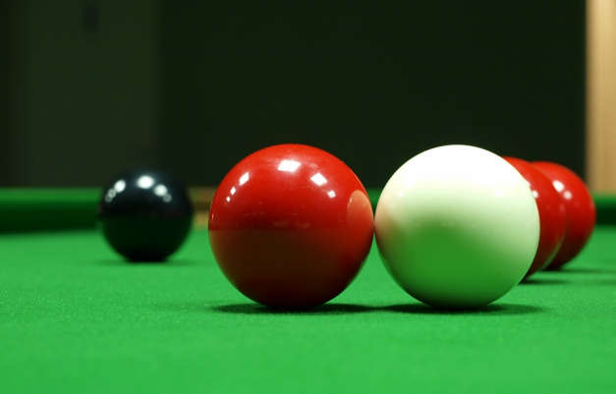
APP PHYSICS 157
IMAGE SEGMENTATION
LIMITATIONS OF THRESHOLDING
Figure 3. Sample image of colored billiard balls and its grayscale equivalent.
Segmenting regions of interest can easily be done through thresholding for grayscale images, but it also has its limitations as well. If we were to consider the image of colored balls, and say for example, we want to segment the red ball, it is almost impossible to do it in grayscale since the red ball has the same grayscale value as the background upon conversion. In practice, 3D objects in general will always have shading variations to it where different brightness of the same color must be considered. For this reason, it is imperative to separate brightness and chromaticity information of our ROIs into a new color space.

Slide 6
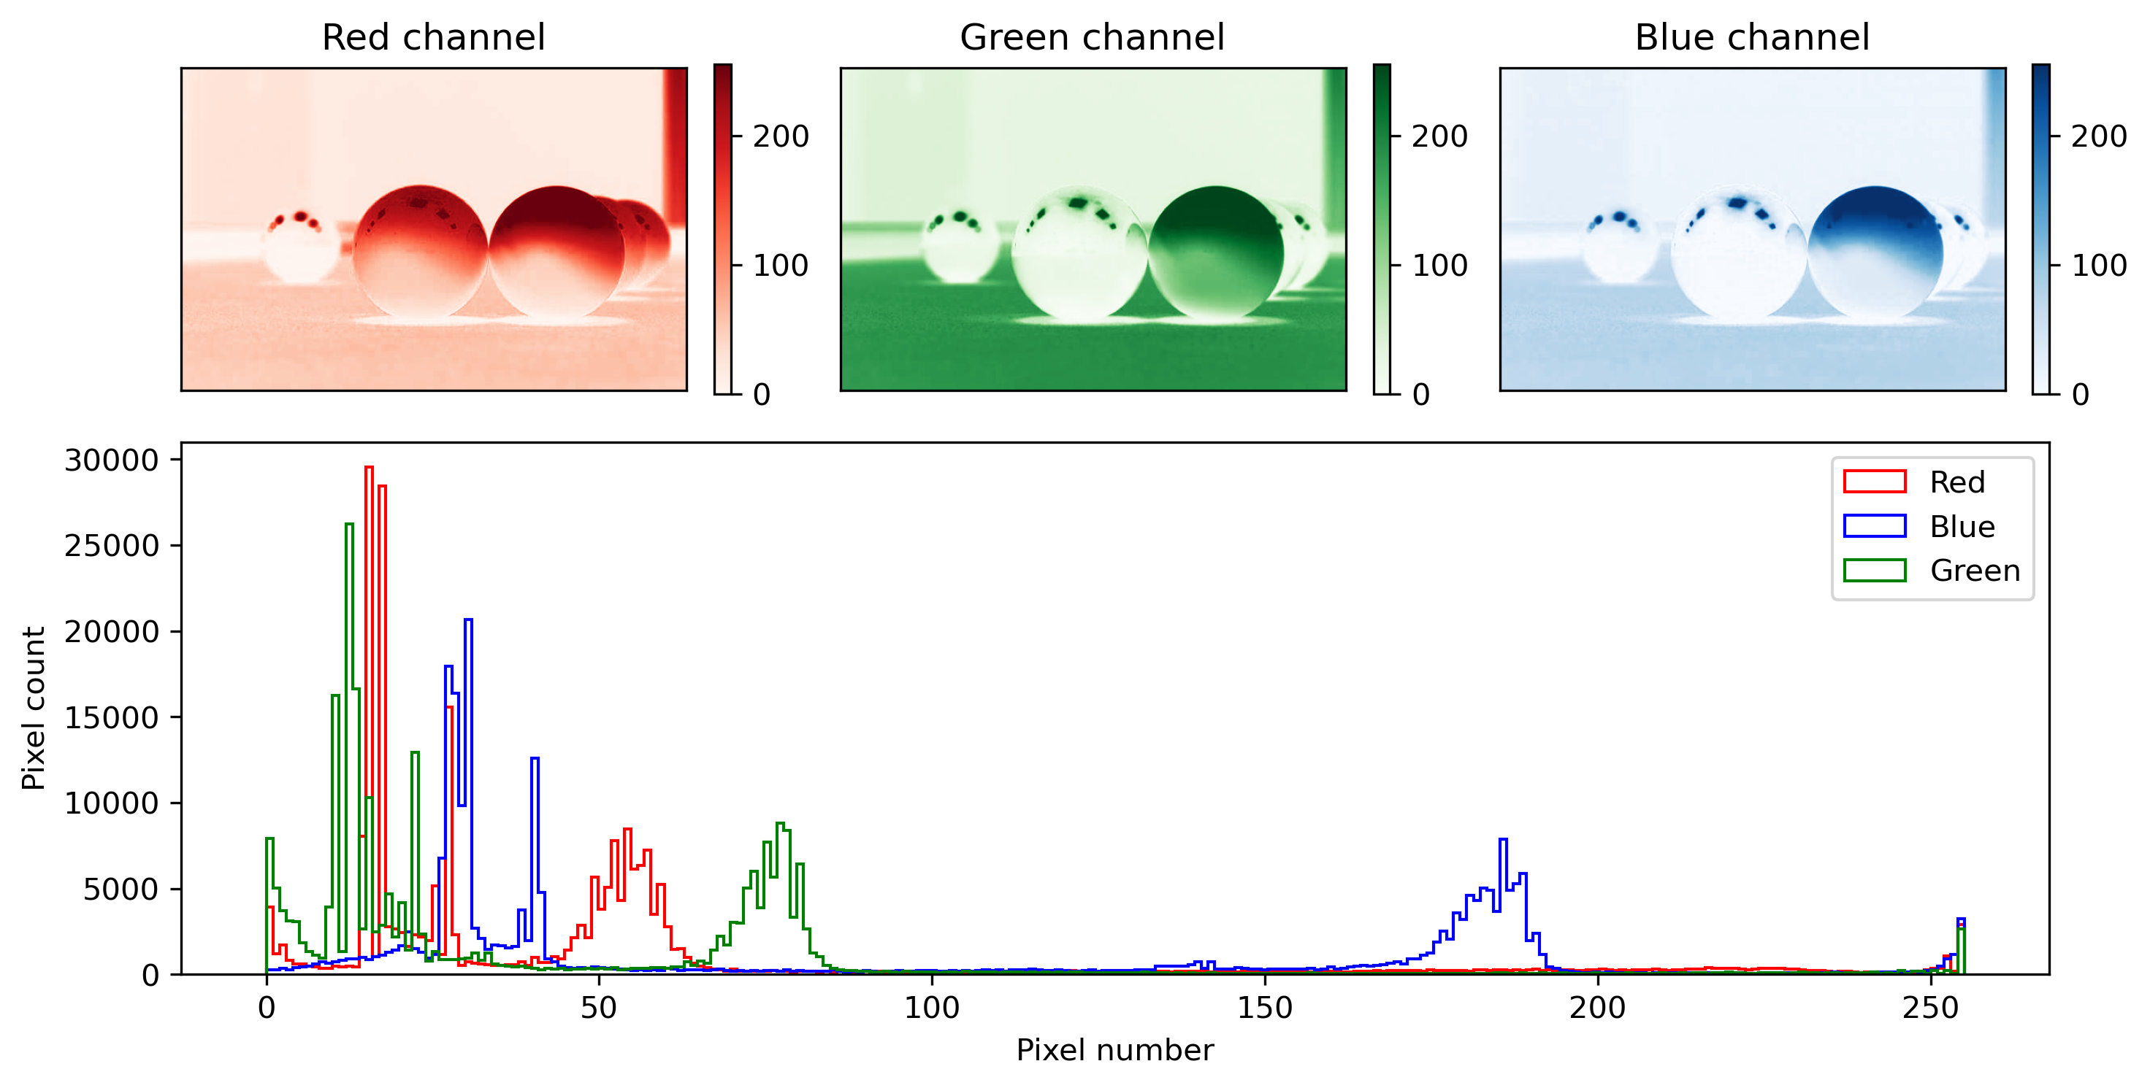
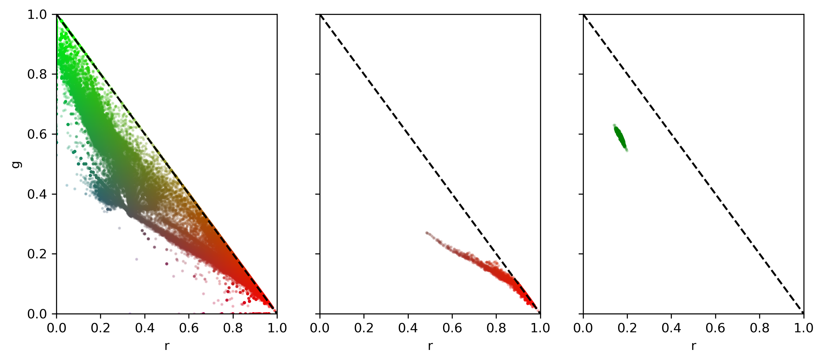
APP PHYSICS 157
IMAGE SEGMENTATION
NORMALIZED CHROMATICITY
Looking at the histogram of the billiard balls, the RGB image has a continuous distribution of the color intensities across the range of pixel numbers below 100. The RGB channels tend to peak at values near 0 due to the dark back-ground that dominates the image itself.
Interestingly, the normalized chroma-ticity coordinates (NCC) of the RGB image, the red ball, and green back-ground were investigated. This basically transforms the 3D RGB color space to a two-dimensional space represented by r and g – where the chromatic information is stored. As expected, the NCC of the red ball tend to occupy a small blob in the red region regardless of its shading variations.
(a) Original image
(b) Red ball
(c) Green background
Figure 4. Histogram of the RGB channels and NCC of the original image from Figure 3.

Slide 7
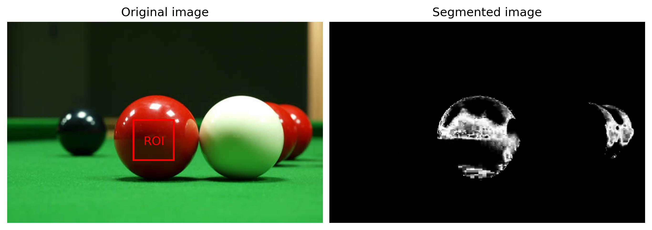
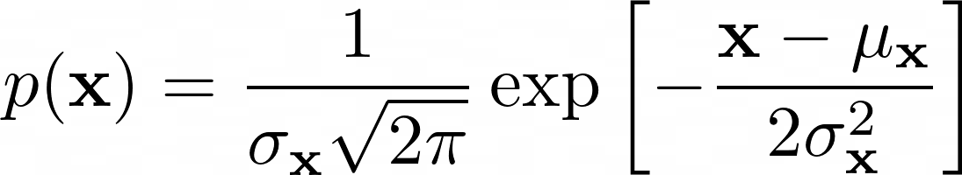
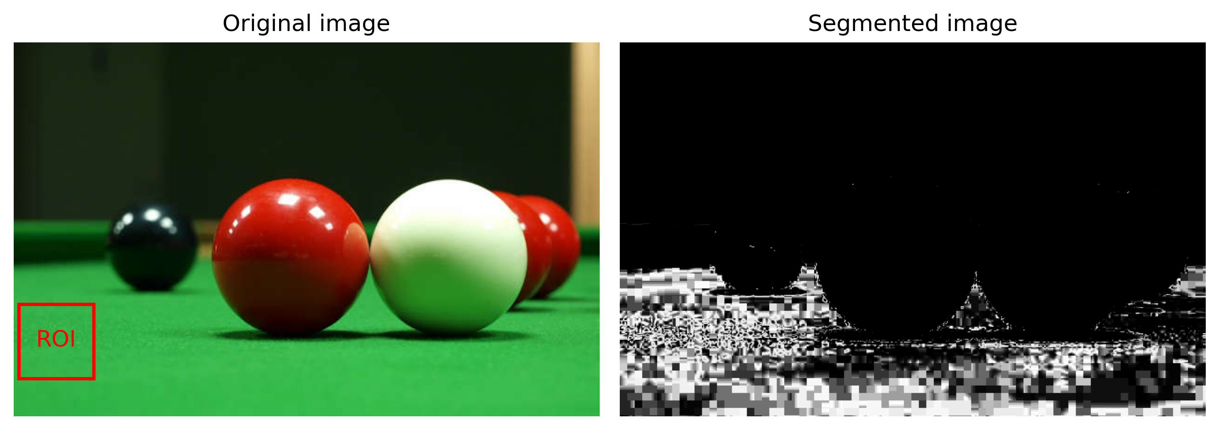
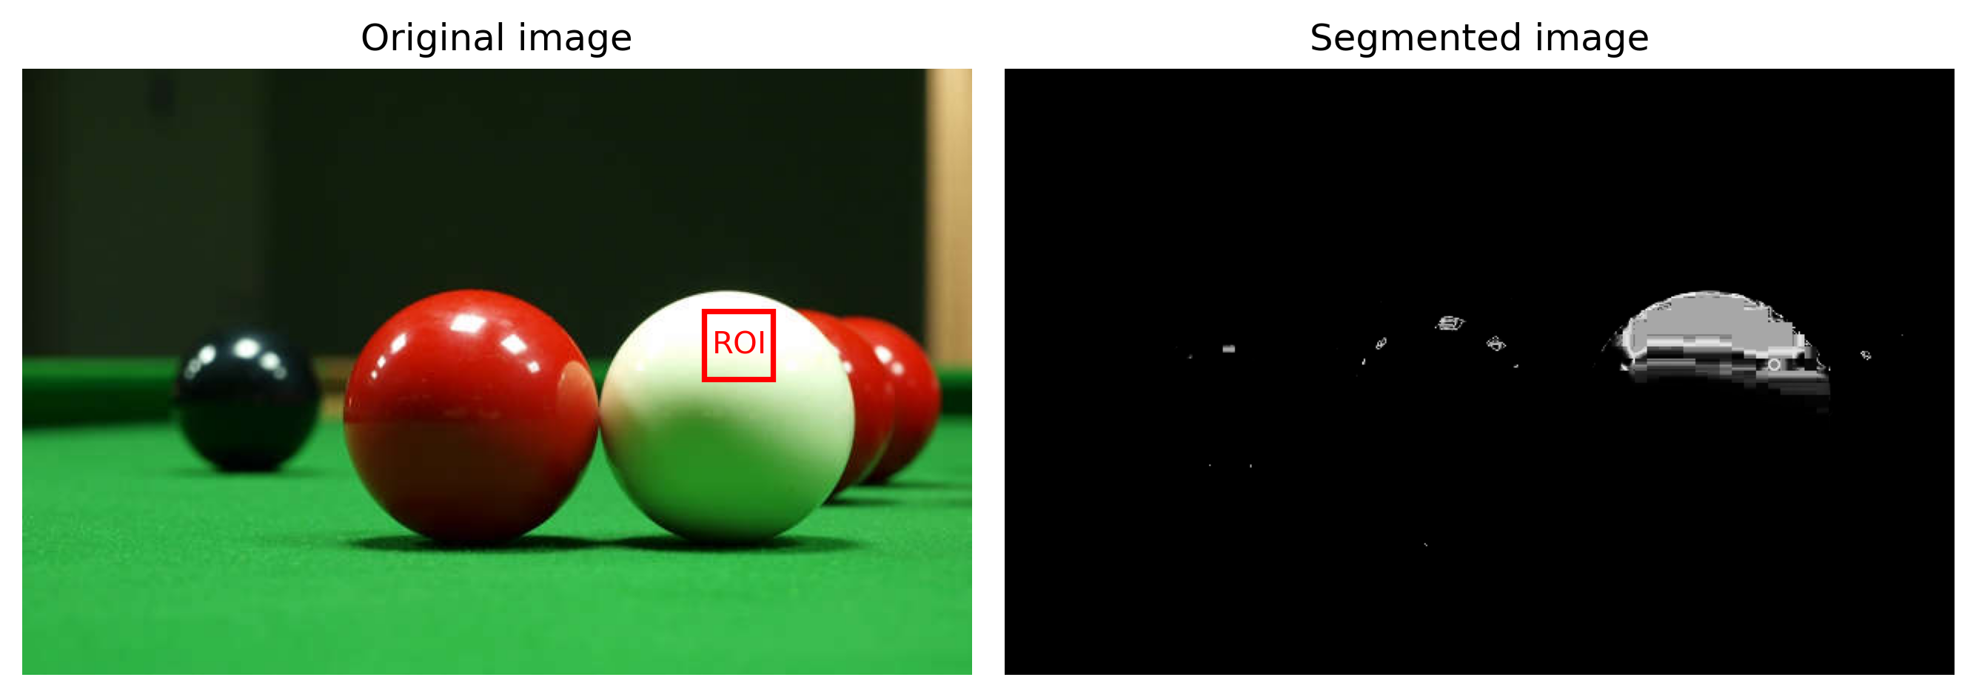
APP PHYSICS 157
IMAGE SEGMENTATION
PARAMETRIC SEGMENTATION
This technique assumes a Gaussian probability distribution given by
in tagging a pixel as belonging to a region of interest or not such that the probability of that pixel belonging to the color of the ROI is quantified. By taking the mean and standard deviation of the pixels contained in the ROI and comparing it to the normalized chromaticity of the original image, the joint probability of r and g test the likelihood of the pixel membership to the ROI and the resulting quantity is the segmented image itself.
Figure 5. Parametric segmentation on the billiard balls for varying ROIs.

Slide 8
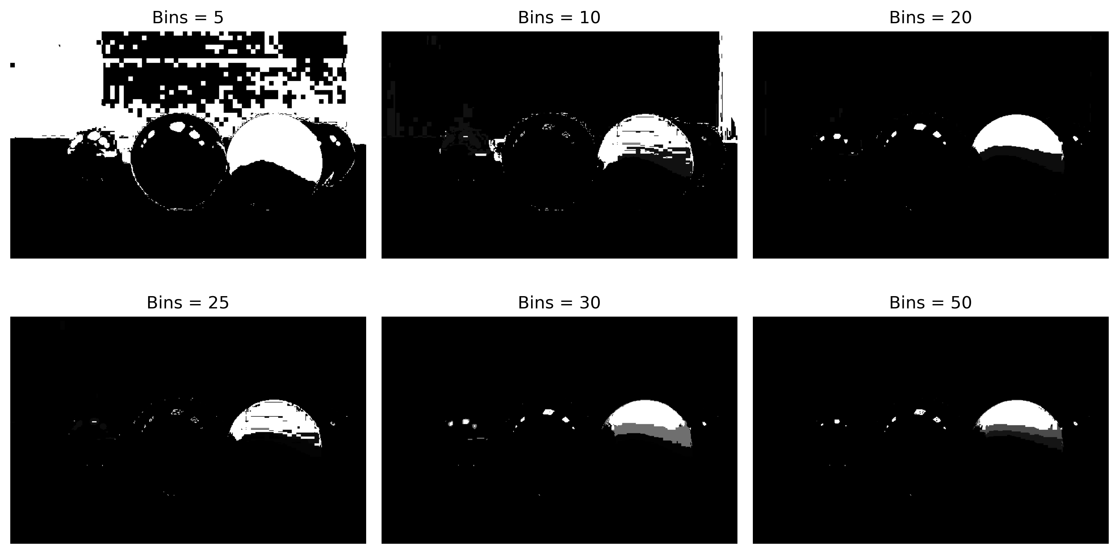
APP PHYSICS 157
IMAGE SEGMENTATION
NONPARAMETRIC SEGMENTATION
In principle, nonparametric segmentation is computationally faster as no computations are needed, just a look-up at the histogram values. In this estimation, the histogram itself is used to tag the membership of pixels belonging to the image through backprojection techniques. This can be done by obtaining a 2D histogram of the RGB values transform into the NCC space, and binning the image values in a matrix.
Effect of bin sizes. The bin sizes can be treated as the defining parameter for non-parametric segmentation. For varying bin sizes, it was perceived that the amount of pixel being tagged varies for increasing bin number – larger bin sizes mean smaller bins for the look-up table. This results to the
Figure 6. Nonparametric segmentation for varying bin sizes.
segmentation or pixel tagging be more specific. This is why in smaller bins (5 to
10) yields a segmented image that includes some unwanted elements from the background!

Slide 9
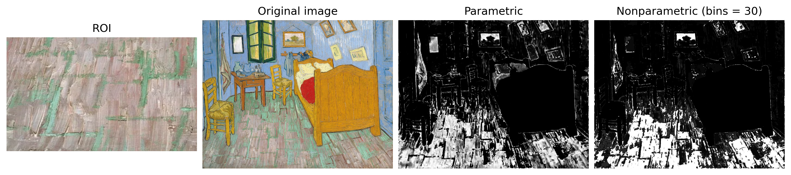
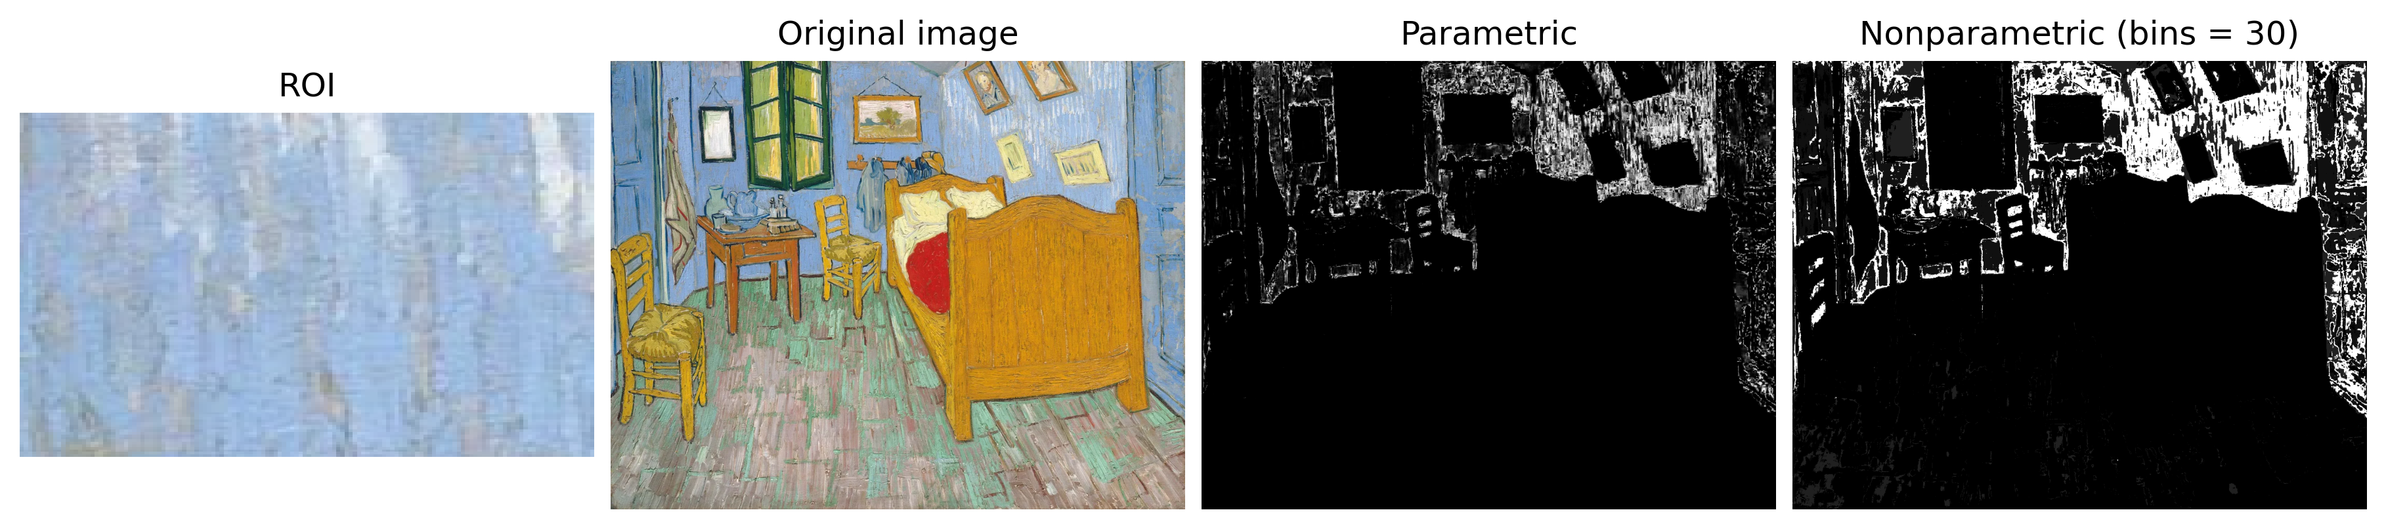
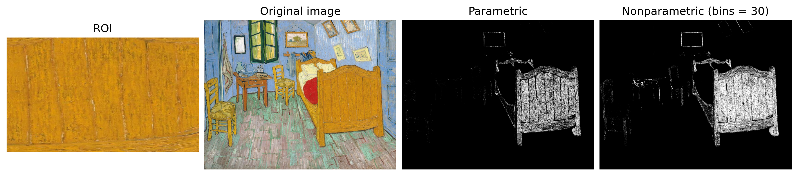
APP PHYSICS 157
IMAGE SEGMENTATION
We experiment with some known paintings of Van Gogh such as the The Bedroom and compare how parametric and nonparametric segmentation algorithms differ.

Slide 10
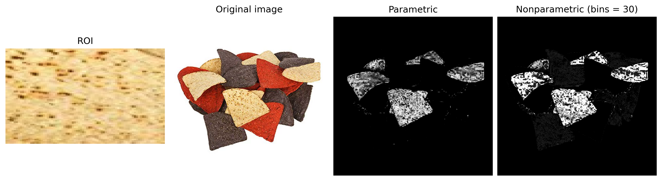
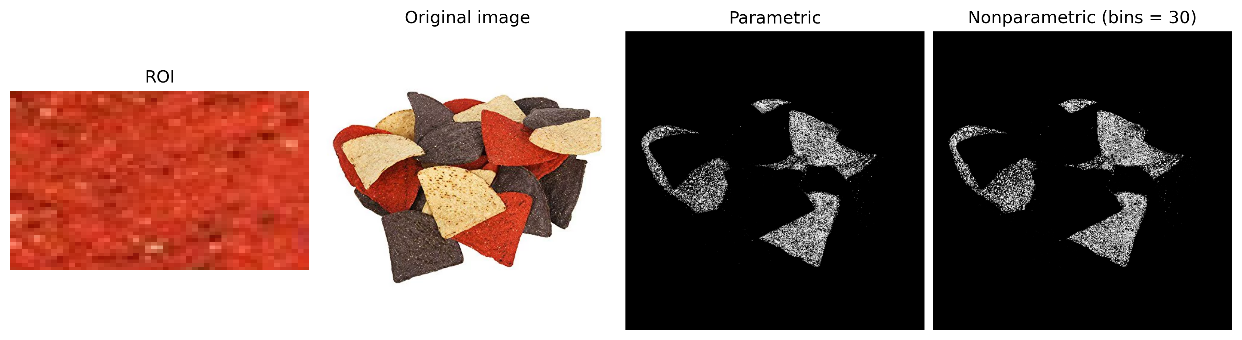
APP PHYSICS 157
IMAGE SEGMENTATION
Figure 7. Comparison of the parametric and nonparametric segmentation using some colored chips.
For the light brown chips, some portions of the dark brown chips were tagged and segmented for the nonparametric estimation. This implies that larger bin size should be set to obtain a much-defined result as much as possible. Nonetheless, both techniques are quite similar for images that has a distinct and clear contrast in between colors and the background like the image of the chips used.

Slide 11
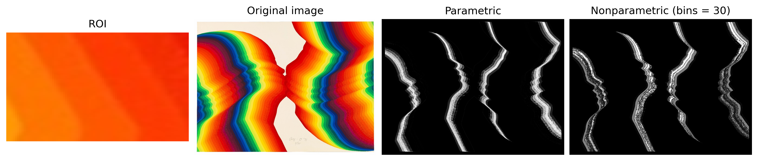
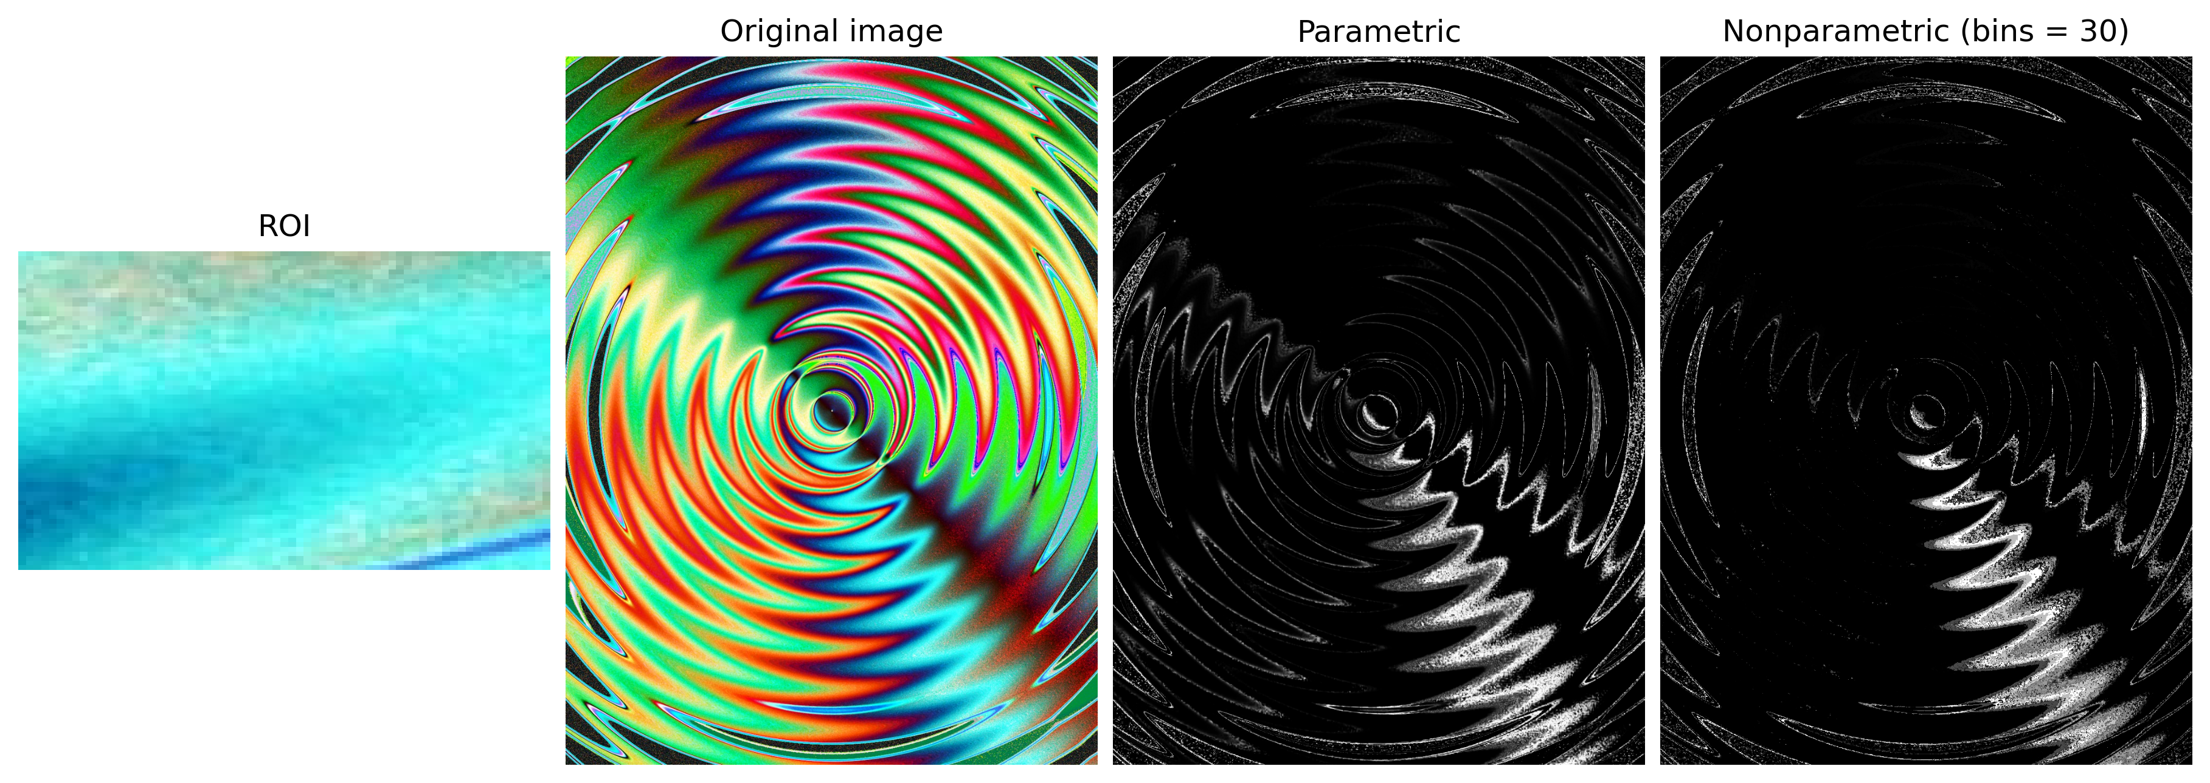
APP PHYSICS 157
IMAGE SEGMENTATION
CONTINUOUS IMAGE AND ROI
For continuous color distributions in the image or ROIs, parametric segmentation tend to have some gradient in result – possibly due to its Gaussian parameters while the nonparametric method have shown discrete segmentation layers that is not as smooth as the parametric. This is because of the binning nature of the segmentation technique. Still, both techniques are worth comparing for continuous RGB images.
Figure 6. Nonparametric segmentation for varying bin sizes.

Slide 12
APP PHYSICS 157
IMAGE SEGMENTATION
REFLECTION
I find the activity fun as I get to work and understand the algorithms behind image segmentation. While having ImageJ as a readily available application for segmenting images, nothing beats the feeling of having to know how to segment images from code and scratch! I was able to learn the different image segmentation techniques and account for the pitfalls that I have encountered in my codes. Overall, I would give myself a score of 110/100 !
REFERENCES | GITHUB
M. Soriano, Applied Physics 157 – Image Segmentation, 2023.

